Slide 1






VITALIS
The AI Healthcare Agent That Doesn’t Just Advise — It Acts
Built for every patient — from first symptom to lasting prevention

Slide 2


THE PROBLEM
6 critical gaps in today’s healthcare journey
People get symptoms, but not direction. They get advice, but not the next step.
Unreliable self-diagnosis
No sense of urgency
No path to the right care
Vague symptom searches lead to confusion, panic, or false reassurance.
Patients can’t tell if a symptom needs rest, a clinic, or an ER.
Finding a nearby, specialist-equipped hospital is left to the user.
Missed medications
Hereditary risks ignored
Reactive, not preventive
Dosage schedules are forgotten, especially by elderly patients.
Family disease patterns go untracked until symptoms appear.
Most apps treat illness after the fact, not before it.

Slide 3







WHO WE SERVE
Every kind of patient is our focus
Vitalis is designed around one truth: healthcare needs differ by life stage, geography, and history.
Everyday Patients
Elderly & Chronic
Rural & Tier-2
Busy Professionals
At-Risk Families
Anyone unsure whether to self-treat, see a doctor, or head to the ER.
Need consistent medication tracking and fast specialist access.
Limited specialist access — need clear direction to capable care.
Erratic schedules leave no room to research care options themselves.
Want to move from reacting to disease to actively preventing it.

Slide 4


WHY IT MATTERS
The gap between symptom and care is where harm happens
01
02
03
Delay costs outcomes
Non-adherence undermines care
Access gaps waste critical time
Chronic conditions like heart disease and diabetes are far more treatable when caught early — yet most people only act once symptoms are severe.
Forgotten doses and skipped follow-ups quietly erode the value of every diagnosis and prescription.
In emergencies, minutes matter — uncertainty about where to go can be as dangerous as the symptom itself.
Vitalis exists to close that gap — turning uncertainty into a clear, immediate next step.

Slide 5






OUR SOLUTION
Vitalis: guidance that ends in action
An AI health agent that reasons about symptoms, decides urgency, and carries the user through to care and prevention.
Understand
Reason
Direct
Prevent
Symptom & context intake
AI triage & severity check
Best-fit hospital / care path
Family risk & lifestyle plan
One continuous loop — not four disconnected tools. Vitalis is the only layer of the healthcare journey that stays with the patient from first symptom to long-term prevention.

Slide 6



FOUNDATION FEATURES
Everyday health support, always on
AI Symptom Checker
Medicine Reminders
Conversational intake that interprets symptoms in plain language and assesses likely causes.
Personalized dosage schedules with adaptive alerts for adherence.
Diet Recommendations
Exercise Plans
Nutrition guidance tailored to condition, goals, and preferences.
Activity suggestions calibrated to health status and recovery needs.
These are table stakes. What makes Vitalis different comes next.

Slide 7



SIGNATURE FEATURE 01
Smart Hospital Navigator
From "what’s wrong with me" to "walk in here" — in one flow.
Severity Triage
Emergency SOS Mode
Classifies urgency — self-care, clinic, urgent care, or emergency — before any hospital is suggested.
For high-severity cases, Vitalis instantly surfaces the nearest ER with live ETA and shares location with an emergency contact — turning critical minutes into a guided response.
Specialty Matching
Ranks nearby hospitals by department fit, not just distance — cardiology, ortho, dermatology, and more.
Distance, ETA & Ratings
Shows travel time, patient ratings, and live map view for every recommended hospital.
One-Tap Navigation
Launches Google Maps directions instantly — no app-switching, no searching.

Slide 8


SIGNATURE FEATURE 02
Family Health Risk Mapping
Preventive care that starts before symptoms ever appear.
1. Build Family Profile
2. Detect Hereditary Risks
Users log medical history for parents, grandparents, and siblings in a simple guided form.
AI flags elevated risk for conditions like diabetes, heart disease, and hypertension based on lineage.
3. Personalized Prevention
4. Proactive Check-ups
Tailored lifestyle, diet, and screening recommendations matched to each identified risk.
Scheduled nudges for the screenings that matter most for that individual’s risk profile.
Reactive care treats illness. Vitalis helps families get ahead of it.

Slide 9
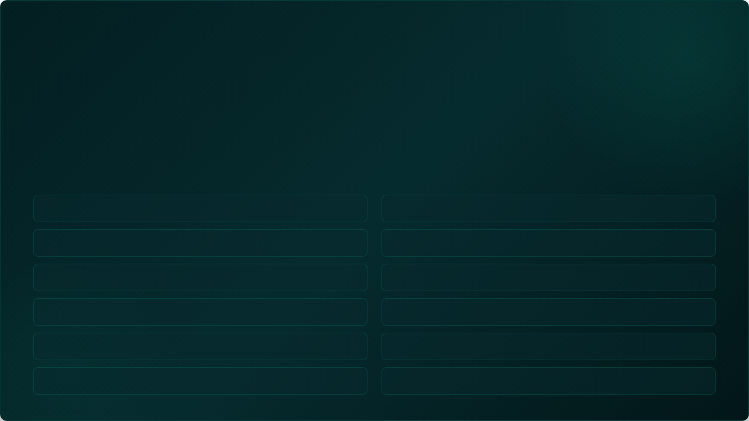
AGENT CAPABILITIES
What Vitalis is actually able to do
Every capability below maps to a real action the agent takes on the user’s behalf.
Classify symptom severity and urgency level in real time
Match symptoms to the right medical specialty or department
Rank and recommend nearby hospitals by fit, rating, and ETA
Launch live Google Maps navigation to the chosen hospital
Trigger Emergency SOS with location sharing for critical cases
Schedule and send adaptive medicine reminders
Build and analyze a multi-generation family health profile
Generate personalized preventive and lifestyle recommendations
Explain lab reports and prescriptions in plain language
Flag potential drug interactions across active medications
Send proactive check-up and screening reminders
Follow up after a visit to track recovery progress

Slide 10


UNDER THE HOOD
The data and tools that power Vitalis
Reasoning Layer
Location & Care Layer
•
LLM-based symptom & triage reasoning engine
•
Google Maps / Places API — distance, ETA, navigation
•
Hereditary risk inference over family health data
•
Hospital directory: specialties, ratings, bed data
Health Data Layer
Engagement Layer
•
Digital health record & prescription/report storage
•
Push notification & reminder scheduling engine
•
Drug interaction & dosage reference database
•
Follow-up and recovery check-in workflows

Slide 11
THE DIFFERENCE
Typical health apps advise. Vitalis moves you.
Typical Healthcare App | Vitalis
Suggests possible conditions | Triages urgency and tells you what to do next
Leaves hospital search to the user | Recommends, ranks, and navigates to the right hospital
Generic reminders | Adaptive reminders tied to real prescriptions
Reacts to reported symptoms | Maps hereditary risk before symptoms appear
One-time advice session | Follows up through recovery and prevention

Slide 12



From symptom to solution.
This is Vitalis.
An AI healthcare agent for every patient — guiding, directing, and preventing, not just informing.

